Slide 1
Brexit: Impact Of The Deal
Alexander Baert
10 februari 2021

Slide 2
Where are we now?

Slide 3
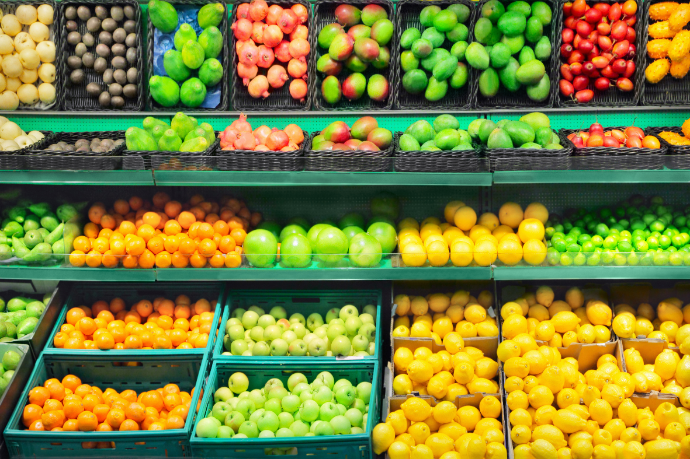
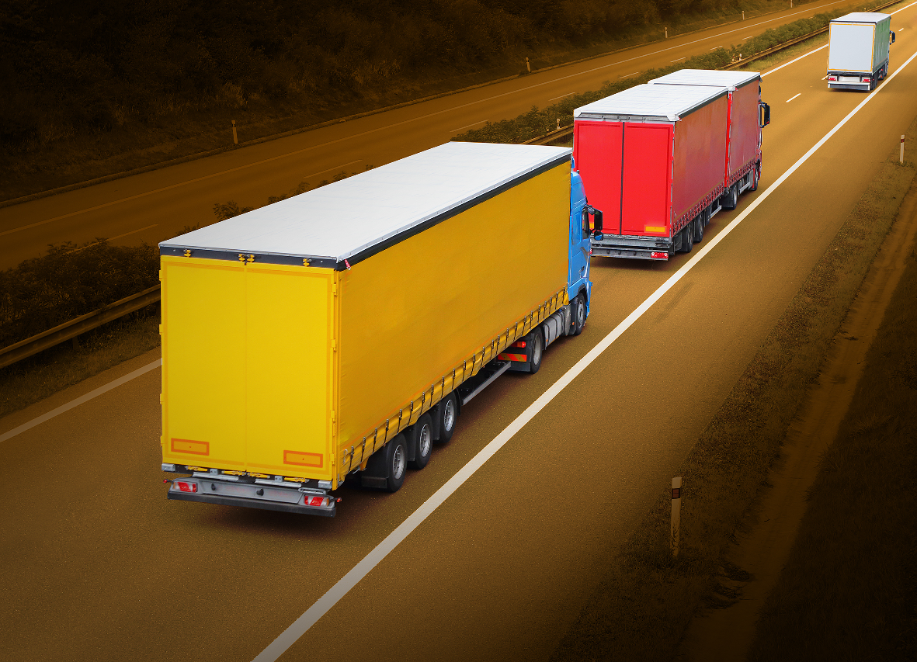
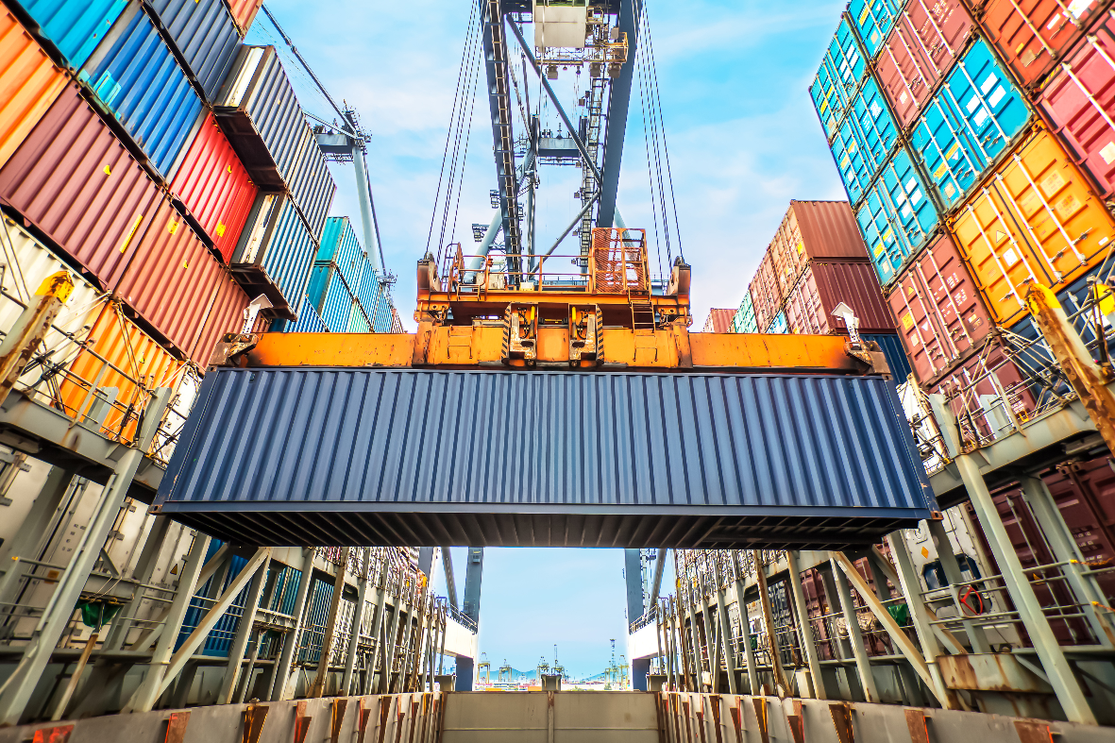
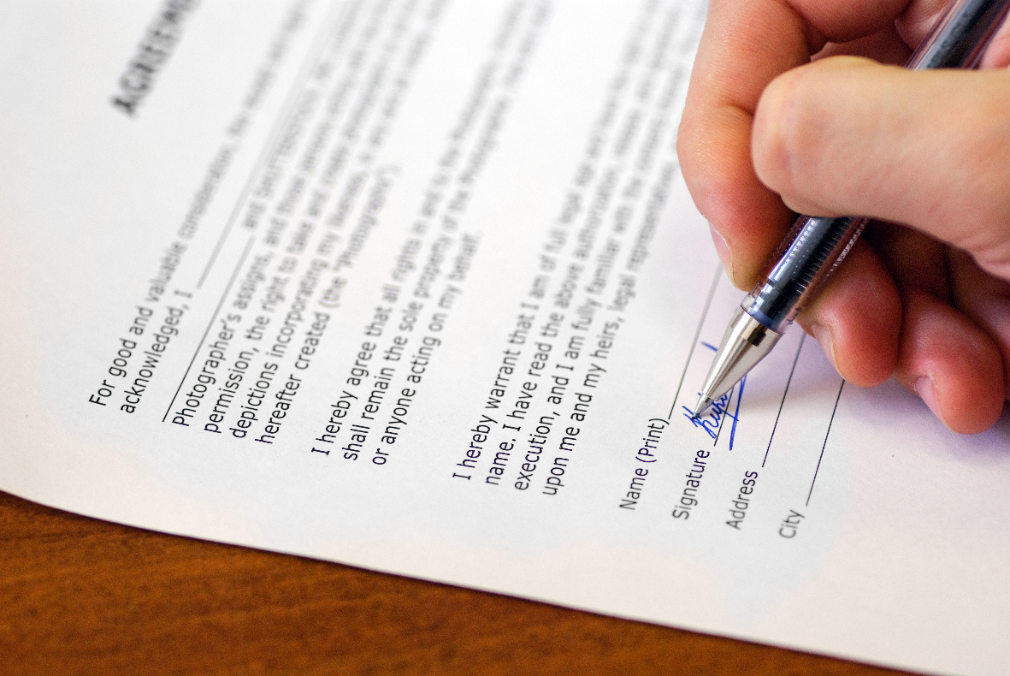
What is in the UK-EU Trade and Cooperation Agreement?
Trade in goods
Technical barriers to trade and SPS measures
Rules of origin
Customs and trade facilitation
International road transport
Mutual recognition of professional qualifications
Financial services
Data and digital
Cross-border trade in services
Intellectual property
Government
Temporary entry and stay for business purposes
Social security coordination and healthcare arrangements
Tax
Participation in Union programmes

Slide 4
What is in the UK-EU Trade and Cooperation Agreement?
​ |  | ​ | EU Member State​ | EU-UK Trade deal​ | WTO​
 |  | ​ | 27 Member States​ | UK​ | Australia​
Frictionless movement of goods, services & capital​ |  |  | Yes​ | No​ | No​
Absence of tariffs and quotas on goods trade​ |  | ​ | Yes​ | Yes​ | No​
Free movement of people​ |  | ​ | Yes​ | No​ | No​
Free to negotiate trade deals​ |  | ​ | No​ | Yes​ | Yes ​
EU laws and regulation​ | Influence​ | ​ | Yes​ | No​ | No​
 | Compliance​ | ​ | Yes​ | Some​ | No​
Fiscal contributions​ |  | ​ | Yes​ | No​ | No ​
Common Agricultural Policy (CAP)​ |  | ​ | Yes​ | No​ | No​

Slide 5
Where are we now?
Post-transition period timeline
Digest
Implement
Adapt
Assess the government guidance
Calculate where changes may need to be made to business operations that have been fundamentally altered by Brexit
Take the steps necessary to implement the changes required as fast as possible
Ensure custom processes are up to date
Communicate with your people the changes to their mobility
Implement tax changes
Adapt any previous planning to take into account the new deal
Identify issues that no longer require immediate remediation but may need to be monitored in the longer term
Data
Social security
Tariffs and quotas
1 January 2021, transition period ends
July 2021, data interim period ends
1 January 2022, UKCA marking required
1 October 2022, food labelling changes
July 2021, full customs declarations required for UK imports

Slide 6
Customs duties and border controls

Slide 7
Customs building blocks
Classification, valuation and origin
Key elements to determine the amount of duty payable:
Origin
The origin of the product is important, particularly where there is an FTA in place and the origin of the product reduces the customs duty payable
General and product-specific rules of origin
Proof of origin
Impact on sourcing strategy
Valuation
Determining the correct value can be complex where, for example, there are numerous sales or a ‘principal’ company business model
Customs valuation methodology
Interaction with Transfer Pricing
Classification
Determining the correct commodity code for the product
UK Global Tariff
EU Tariff
Check that commodity codes are correct

Slide 8
Rules of Origin in the UK-EU Trade and Cooperation Agreement (TCA)
The TCA eliminates all customs duties on goods which originate in the other party
Comprehensive rules of origin determine when and how goods originate in the UK or the EU
Full bilateral cumulation of origin, which allows traders to include the value of components originating, and processing undertaken, in either the UK or the EU when determining origin
Proving origin: importer’s knowledge or supplier statement or declaration. Simplified arrangements in place
Importers have up to three years from the date of import to claim preferential tariff treatment
UK – EU FTA
UK – ROW FTAs
UK and EU content will be regarded as qualifying content under that FTA
In UK-ROW FTAs, UK content-only will be regarded as qualifying content

Slide 9
Rules of Origin
Example supply chains
EU origin goods, exported from the EU into the UK Chinese Origin goods, exported from China to the EU, then subsequently exported to the UK Finished EU origin goods, exported from the EU into the UK and then returned to the EU Intermediate EU origin goods, exported to the UK for further processing and then returned to the EU
Canadian origin goods, exported from Canada to the UK and then exported to the EU
Key customs considerations
Rules of origin
Cumulation
Customs Warehousing
Insufficient Processing
Sufficient Processing
Direct transport versus non-manipulation

Slide 10
UK phased border controls
Full border controls will be introduced in Great Britain in three phases, and will become fully effective from 1 July 2021:
Importers of standard ‘non-controlled’ goods will have up to six months after import to submit a customs declaration (and payments of associated customs duty will be deferred until submission of the customs declaration)
There will be checks on controlled goods such as tobacco and alcohol, and customs declarations for such imports will be required at the border
Importers of products of animal origin (POAO) and all regulated plants and plant products will require pre-arrival notification and submission of relevant health documentation
Importers moving all goods will have to make full declarations and pay tariffs at the point of importation (subject to any customs authorisations in place such as CFSP)
There will be increased checks on animals, plants and associated products
1 January 2021
1 April 2021
1 July 2021

